Slide 1
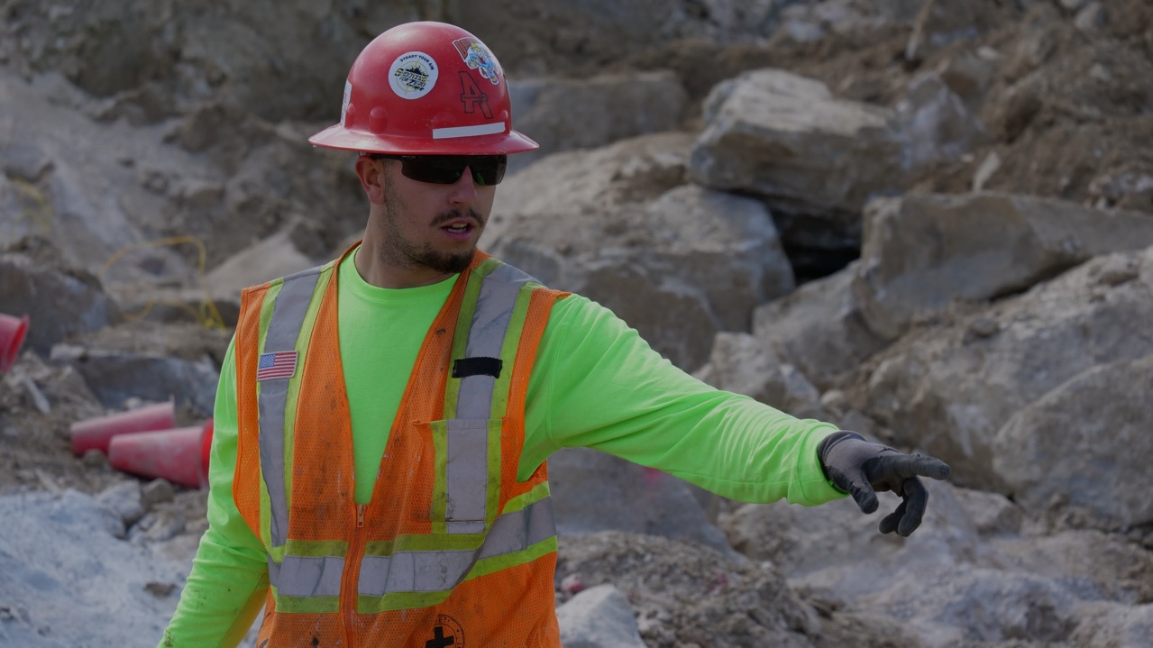

Beneath The Surface
Addressing Mental Health and Suicide in Mining
Presented to:
Date

Slide 2
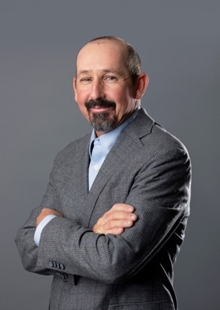
Rory Wilson
Background:
30 years in construction and mining industries
Safety professional
Passionate public speaker
Dedicated advocate for mental health awareness and suicide prevention
rorywilson@amesco.com
Notes:
A seasoned safety professional with over two decades of extensive experience in the construction and mining industries. With a strong background in ensuring the well-being of workers in high-risk environments and brings a wealth of knowledge and expertise to
the field of workplace safety.
Beyond being a safety expert, I am a passionate public speaker, captivating audiences with insightful discussions on a range of topics. Specializing in safety practices in construction, I educate and inspire others on the importance of maintaining a secure work environment. Additionally, I am a dedicated advocate for mental health awareness and suicide prevention, shedding light on crucial issues that often go overlooked in the industry.
Through my unique blend of practical experience and engaging communication skills, I continue to make a lasting impact in promoting safety and well-being within the construction and mining sectors.

Slide 3
WARNING: Sensitive Content
In the following slides, we will be discussing topics related to mental health, substance use, and suicide which may trigger strong emotions.
If you find this content upsetting, please step away or take a moment to compose yourself.
If you or someone you know is struggling, don't hesitate to seek help from a trusted co-worker, friend, family member, or mental health professional. You may also contact the 988 Suicide & Crisis Lifeline.

Slide 4

Exercise
Raise Your Hand Poll.
Notes:
Use this slide to do a quick exercise to show the attendees that each of us have had contact with this topic in some form or fashion.
This point makes it easier to understand that the conversations shouldn’t be as hard to have as they are.
Use this to begin the conversation as to the importance of destigmatizing suicide.

Slide 5



When you hear the word suicide or hear that someone has died by suicide, what is the first word that enters your mind?
The Slido app must be installed on every computer you’re presenting from

Slide 6
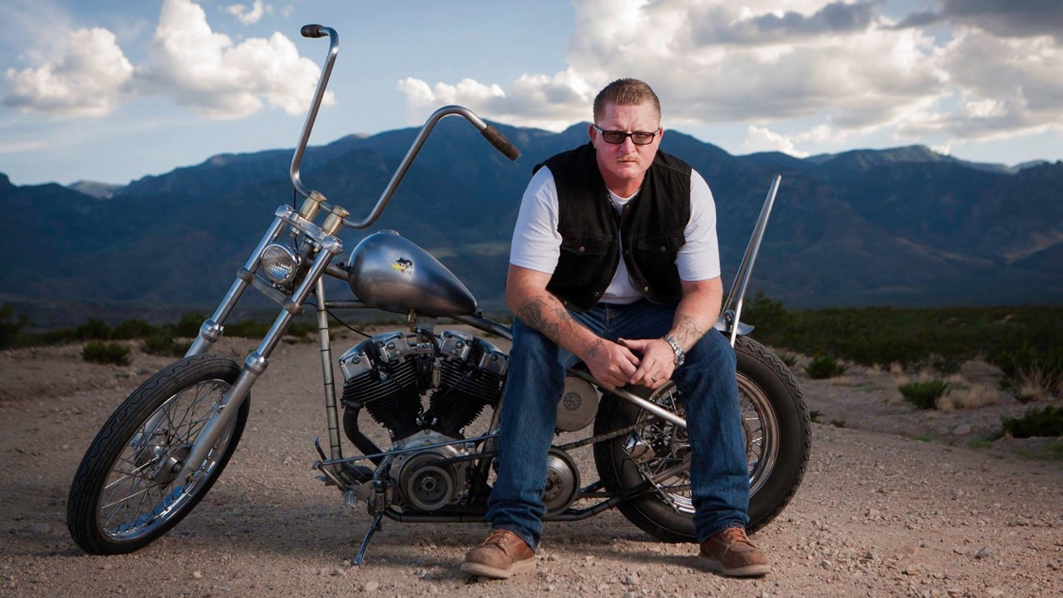
The reason I’m Here

Slide 7
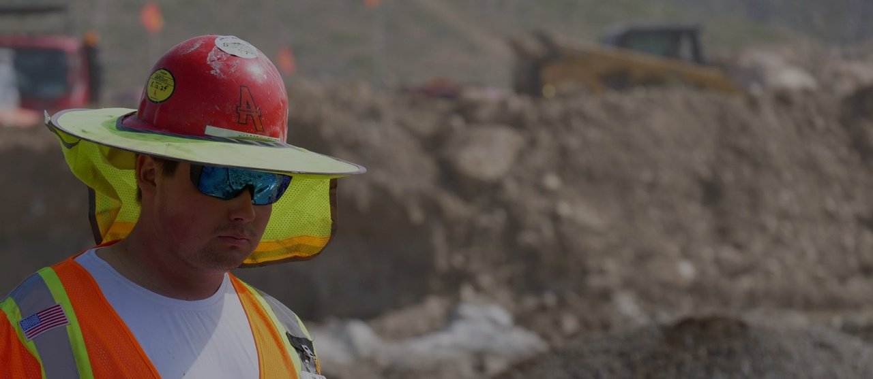
DID YOU KNOW?
You are 5 times more likely to lose a coworker to suicide than to a work- related illness or injury!

Slide 8
Statistics by Market Sector

Slide 9
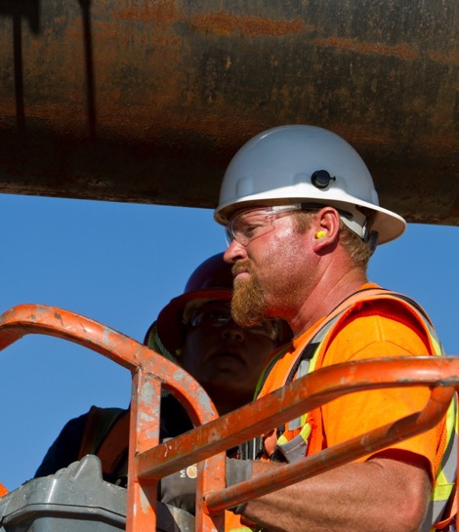
Mental Health in Mining
According to the CDC:
72 mine workers and 56 construction workers out of every 100,000 workers die by suicide.
In stark contrast, the average suicide rate in the United States is just 12.93 individuals per 100,000 people.
The suicide rate amongst these workers is 4+ times the national average.

Slide 10
Key Facts
Studies show that one reason may lie in the composition of our workforce, these industries are male dominated.
83% of mine workers are men.
Men die from suicide 3.5 times more than women
78% of mine workers are white
Suicide rates are highest amongst middle aged men – White men in particular
1.5 of every 10 construction workers are veterans
Veterans are 50% more likely to die by suicide than the general population

Slide 11
Why is this happening?
Culture
Work-Life Balance
Tough in nature
Away from family
Away from support structures
Addiction
Peer Pressure
Stress
Long hours
Travel
Relationships
Sleep disruptions
Instability
“Golden Handcuffs”

Slide 12
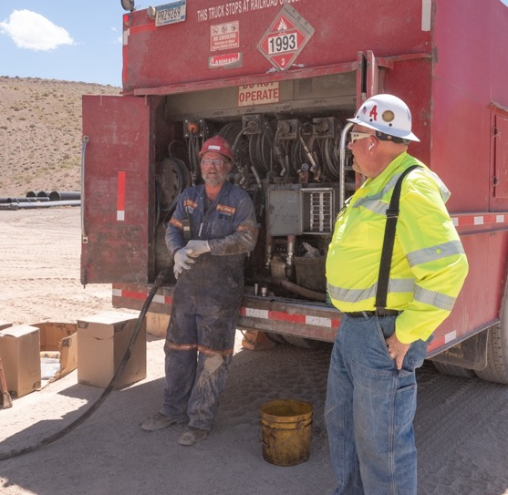
What can we do?
ACTIVELY LISTEN!
If a person talks about…
– Killing themselves
– Feeling hopeless
– Having no reason to live
– Being a burden to others
– Feeling trapped
– Unbearable pain

Slide 13
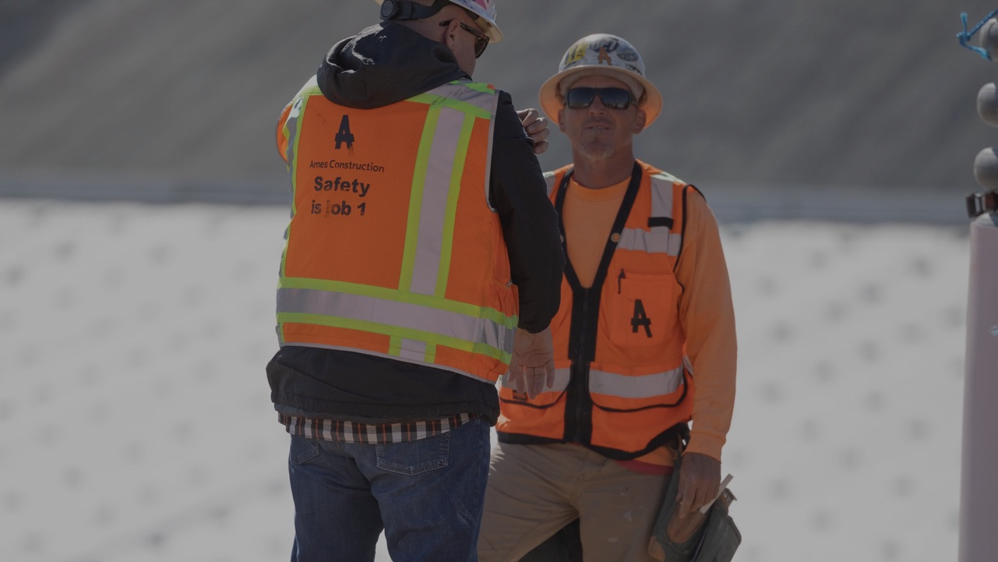
The Art of listening is creating an environment in which the other person feels heard, feels seen and feels understood.
– Simon Sinek

Slide 14
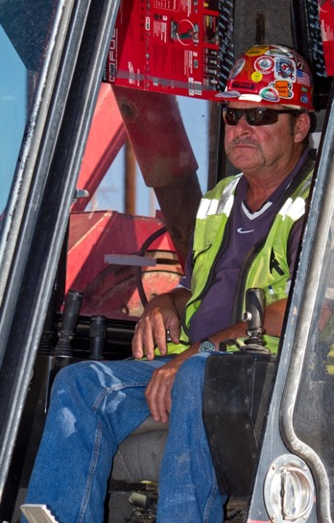
Pay Attention!
BEHAVIOR -Especially after painful event or a loss
Increased use of alcohol or drugs
Withdrawing from activities
Isolating from friends and family
Sleeping to much or to little
Visiting or calling people to say goodbye
Giving away possessions
Aggression
Fatigue

Slide 15
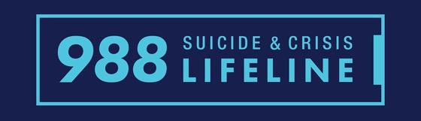
What Can we Do?
Understand!
Our environment
The issues
Our resources
https://988lifeline.org/

Slide 16
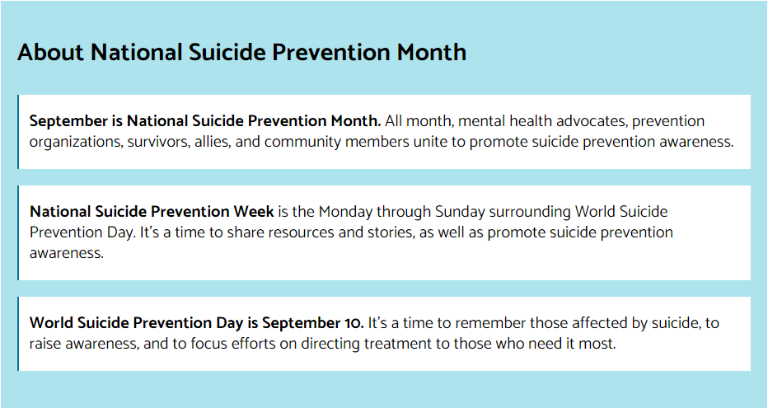
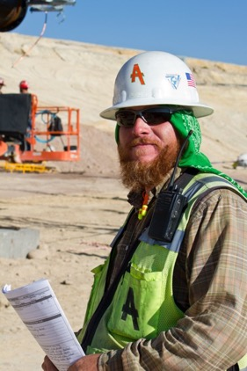
GET INVOLVED!
https://988lifeline.org/promote-national-suicide-prevention-month/

Slide 17


Resources

Slide 18
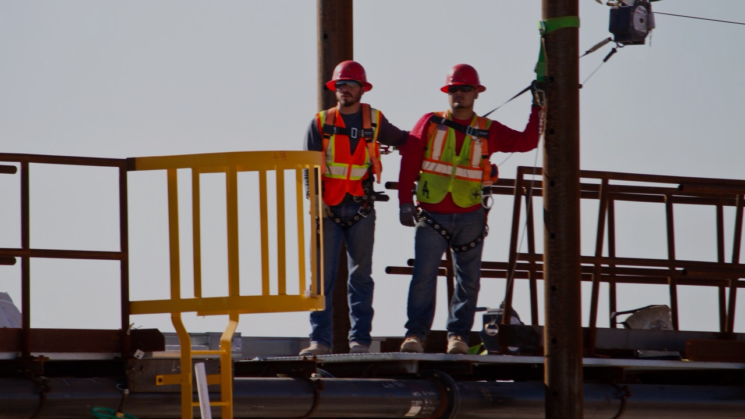
The most important role of a mining professional is to de-stigmatize mental health and serve as the bridge that connects the workers needing support with qualified medical professionals.

Slide 19

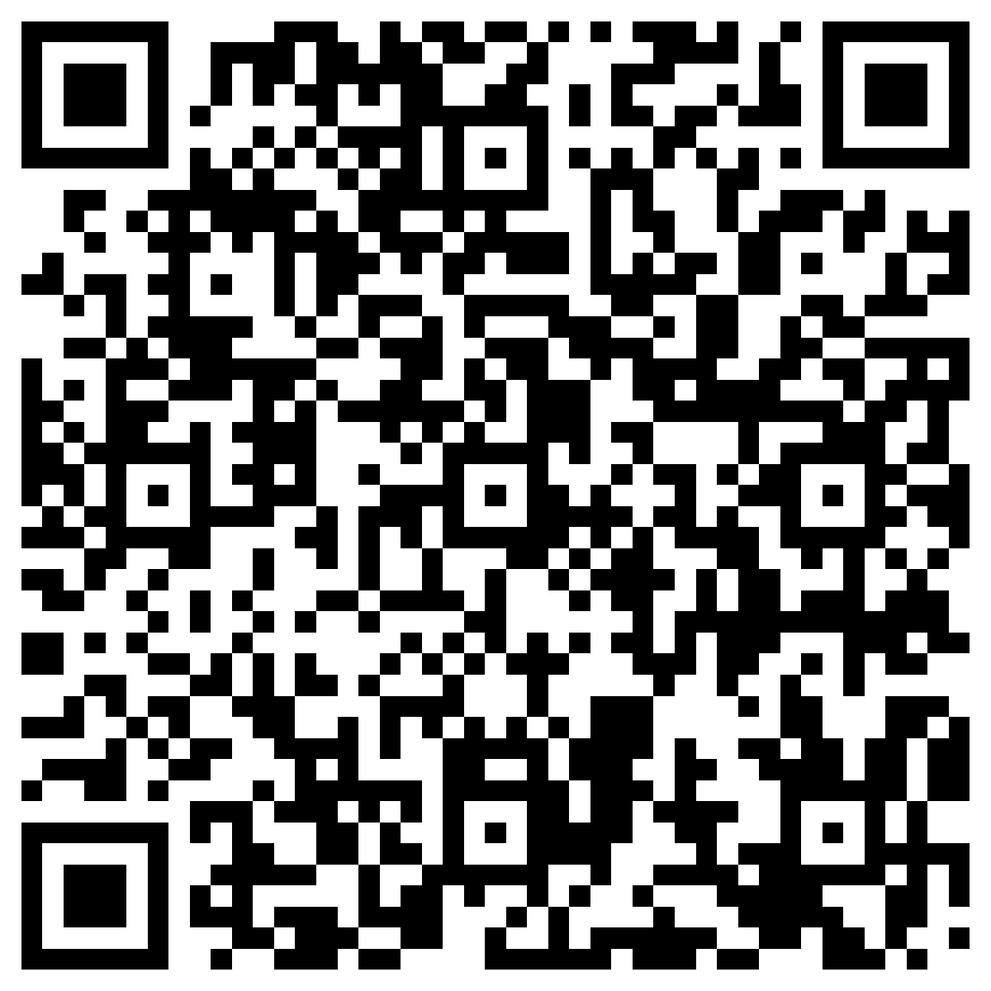
Thank You!
rorywilson@amesco.com
Download this Presentation and more materials.
AmesConstruction.com

